Slide 1
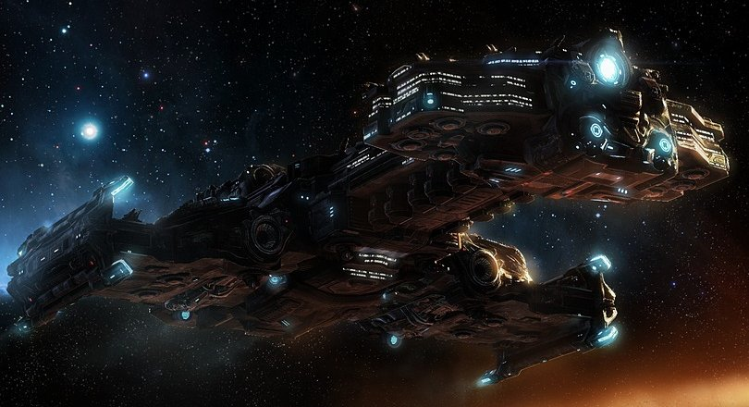
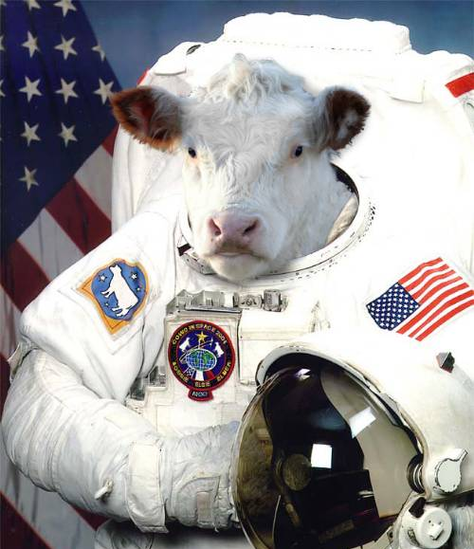
Cattle Bruiser
By: Aedan, Connor, Marcus & Ben

Slide 2
Mission Statement
More strategies → More versatility → Stronger AI
Exploit weaknesses that exist in current popular AI.
Deal with popular rushing tactics → Transition into a strong counter-attack.
Make code that could be useful in many situations.

Slide 3
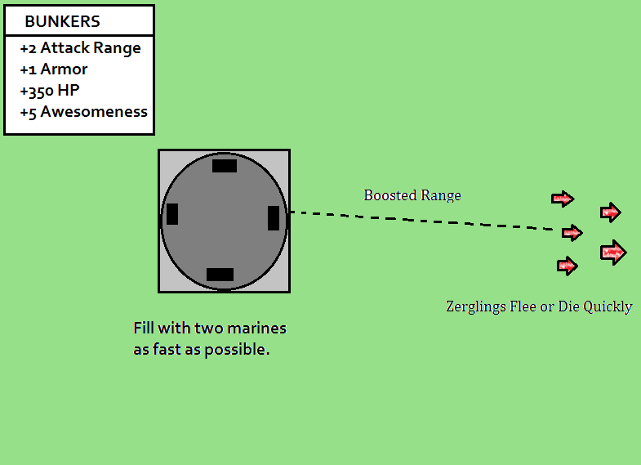
Dealing with WEAKLINGS ZERG
Predictable but deadly, and requiring a solution.
Tested our defense against last years most aggressive 4-pooler; Marvin.
Able to repel rushes successfully on smallest maps.
Bunker code useful in other strategies.

Slide 4

Stimpacks AND YOU
%50 Move/Attack Speed Bonus
Had to monitor several factors:
Are Marines in combat?
Is health too low to be valuable?
Are Stimpacks currently active?
Accounted for Stims in combat simulation.
Results very effective against non-Protoss opponents.
Code could be re-applied to Spidermines or other abilities.

Slide 5
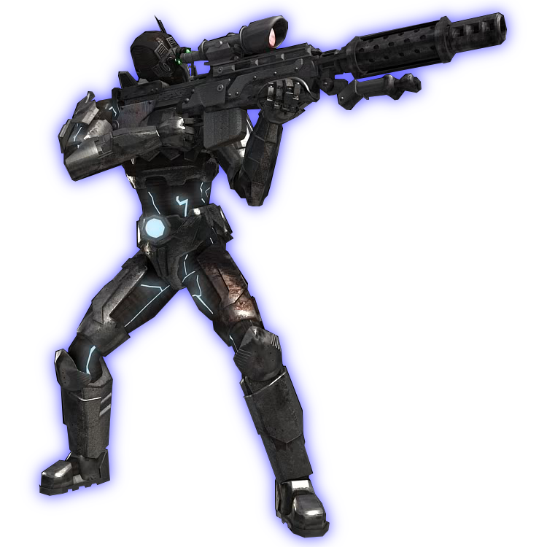
The GO-TO DEFAULT STrat
Needed a strong fall back where more niche strategies did not succeed.
Emphasis on stability.
BEN PLEASE FILL THE REST OF THIS IN, YOU KNOW IT BEST. I’LL MAKE A VID LATER.

Slide 6
Ramp Camp: Our Magnum Opus

Slide 7
Image Sources
http://img3.wikia.nocookie.net/__cb20100717012436/starcraft/images/d/d9/Hyperion_SC2_DevRend1.jpg
http://img2.wikia.nocookie.net/__cb20080627195642/uncyclopedia/images/c/c0/Space_cow.jpg
http://images.complex.com/complex/image/upload/t_article_image/upqjvng41mp02ndgqlbb.jpg
http://img3.wikia.nocookie.net/__cb20080313020107/starcraft/images/9/98/ResearchStimPack_Terran_SC1.png
http://fc09.deviantart.net/fs70/f/2010/207/3/7/Edited_Terran_Ghost_Render_by_B1x.png
http://hydra-media.cursecdn.com/awesomenauts.gamepedia.com/e/e4/UI_Skillbutton_Commando_Stim.png?version=4213ec27561e4aea94e69ff42df7ddaa

Slide 8
THE END

